Slide 1
Operator, Operand, and Arithmetic
Subject : COMP6047
ALGORITHM AND PROGRAMMING
Year : 2015

Slide 2
Learning Outcomes
At the end of this session, student will be able to:
Creating instructions using various operator in C programming language (LO1 & LO2)

Slide 3
Sub Topics
Operator, Operand, and Arithmetic:
Operator and Operand Introduction
Assignment Operators
Arithmetic Operators
Relational Operators
Conditional Expressions
Logical Operators
Bitwise Operators
Pointer Operators
Precedence and Associative
Exercise

Slide 4
Operator and Operand Introduction
Operator is a symbol to process values in result for a new value
Operand is part which specifies what data is to be manipulated or operated on
Example :
C = A + B
(= and + sign are operators, A, B and C are operands)
Based on its operand number, operator can be divided into three:
Unary operator (needs one operand)
Binary operator (needs two operands)
Ternary operator (needs three operands)

Slide 5
Operator and Operand Introduction
Based on its operation type, operator can be grouped as:
Assignment Operator
Logical Operator
Arithmetic Operator
Relational Operator
Bitwise Operator
Pointer Operator

Slide 6
Assignment Operators
A binary operator
Used in assigning value to an operand
Syntax:
Operand1 = Operand2;
Left hand side operand (Operand1) should have (L-Value) such as variable
Right hand side operand (Operand2) can be constant, another variable, expression or function

Slide 7
Assignment Operators
Example:
x = 2; // constant
x = y; // other variable
x = 2 * y; // expression
x = sin (y); // function
Type of the result will follow the left hand side operand
int x = 7/2; /*x value is 3 not 3.5*/
float y = 3; /*y value is 3.000 */

Slide 8
Arithmetic Operators
Symbol | Functionality | Example
+ | Addition | x = y + 6;
- | Subtraction | y = x – 5;
* | Multiply | y = y * 3;
/ | Division | z = x/y;
% | Modulo | A = 10 % 3;
++ | Increment | x++;
-- | Decrement | z--;
() | Scope / Priority | x=(2+3)*5

Slide 9
Arithmetic Operators
Modulo
Symbol : %
Binary operator
To find remainder of a division
N % 2, can be used to find an odd or even number
N % 2 = 0 → N is even
N % 2 = 1 → N is odd
Increment and Decrement
Symbol : ++(increment), --(decrement)
Unary operator
Increase (++) and decrease (--) the value of a variable by 1.
Its position can be in the front (pre) or after (post) a variable.

Slide 10
Arithmetic Operators
Example :
N++; // post increment
++N; // pre increment
N--; // post decrement
--N; // pre decrement
If a stand alone statement, N++; or ++N; equal to N=N+1;
If a stand alone statement, N--; or --N; equal to N=N-1;

Slide 11
Arithmetic Operators
Example:
#include <stdio.h>
int main ()
{
int x = 44; int y = 44;
++x;
printf(”x = %d\n”, x); /* result 45 */
y++;
printf(”y = %d\n”, y); /* result 45 */
}

Slide 12
Arithmetic Operators
If ++n and n++ as a bounded statement (sub expression), then both of them have a different meaning
++n → n add by 1, then continue to process its expression
n++ → process the expression initially, than add n by 1
int main () {
int x=44; int y = 44; int z;
z = ++x; /* z, x is 45 */
z = y++; /* z is 44 and y is 45 */
return(0);
}

Slide 13
Arithmetic Operators
Every expression using the following form:
<Variable> = <Variable> <Operator><Exp>;
has similar meaning with:
<Variable> <Operator> = <Exp>;
or also known as:
Combined Operator
Expression | Combined Operator
a = a + b; | a += b;
a = a – b; | a -= b;
a = a * b; | a *= b;
a = a / b; | a /= b;
a = a % b; | a %= b;
a = a ^ b ; | a ^= b;

Slide 14
Arithmetic Operators
Example :
x *= y +1; has similar meaning with:
x = x * (y + 1);
x = x * y + 1;
x = x + 1 * y;
x = (x + 1) * y;
Answer: A

Slide 15
Relational Operators
Use to compare to values with TRUE or FALSE result
FALSE in C language equals to the value of zero
TRUE on the other hand not equal to zero
TRUE set by a C program at run time equal to the value of one
Symbol | Functionality
== | Equality
!= | Not equal
< | Less than
> | Greater than
<= | Less or equal than
>= | Greater or equal than
?: | Conditional assignment

Slide 16
Relational Operators
Example:
#include<stdio.h>
int main()
{
int x=5,y=6;
if ( x == y) printf("%d equal %d\n",x,y);
if ( x != y) printf("%d not equal %d\n",x,y);
if ( x < y) printf("%d less than %d\n",x,y);
if ( x > y) printf("%d greater than %d\n",x,y);
if ( x <= y) printf("%d less or equal than %d\n",x,y);
if ( x >= y) printf("%d greater or equal than %d\n",x,y);
return(0);
}
int x;
x = (20 > 10); // x value 1
x = (20 == 10); // x value 0

Slide 17
Conditional Expressions
Given the following statement:
if(a > b) z = a;
else z = b;
The above statement can be reformed to a conditional expression
Conditional expression using ternary operator : ‘?’ and ‘:’
Syntax :
exp1 ? exp2 : exp3;
Example (similar meaning with the above statement):
z = (a > b) ? a : b;

Slide 18
Conditional Expressions
Example:
int main () {
int code, discount=0;
code=1;
discount = (code == 1) ? 30 : 10;
printf(” Item discount = %d \n”,discount);
return(0);
}
int main () {
int bil, abs;
bil = 50;
abs = (bil1 > 0) ? bil : - bil;
printf(“%d \n”,bil);
bil = - 50;
abs = (bil1 > 0) ? bil : - bil;
printf(“%d \n”,bil);
return(0);
}

Slide 19
Logical Operator
Logical operator symbols:
Logical operator truth table:
Symbol | Functionality
&& | AND
|| | OR
! | NOT
A | B | !A | A && B | A || B
True | True | False | True | True
True | False | False | False | True
False | True | True | False | True
False | False | True | False | False

Slide 20
Logical Operators
Operand in Logical Operator is the operand with TRUE or FALSE value
Example :
int x=5; int y=0;
x && y; // FALSE
(x > y) && (y>=0); // TRUE

Slide 21
Bitwise Operators
Symbol | Meaning | Example
& | AND | A & B
| | OR | A | B;
^ | XOR | A ^ B;
~ | Complement | ~A;
>> | Shift Right | A >> 3;
<< | Shift Left | B << 2;

Slide 22
Bitwise Operators
BIT BY BIT OPERATION
Example:
int A=24; int B=35; int C;
C = A & B; // value C = 0
C = A | B; // value C = 59
Note:
A=24 binary: 011000
B=35 binary: 100011
Bit by bit AND operation resulting: 000000, in decimal: 0
Bit by bit OR operation resulting : 111011, in decimal: 59

Slide 23
Bitwise Operators
XOR operation of two bits resulting 1 if both bit are differ, and will result 0 if both are analogous.
Example:
int A,B=45;
A = B^75; // Result A=102
Note:
Decimal 45 binary: 0101101
Decimal 75 binary: 1001011
bit by bit XOR will result in : 1100110 or 102 in decimal

Slide 24
Bitwise Operators
To create a complement-1 value, then every bit with 0 value exchange to 1 and vice versa.
Example:
int A, B=0xC3;
A=~B; //value A=0x3C;
Note:
0xC3 binary: 1100 0011
complement-1 result:
0011 1100 in hexadecimal 3C
In C, writing a hexadecimal should start with 0x

Slide 25
Bitwise Operators
Example :
int A, B=78;
A = B >> 3; //value A=9
A = B << 2; //value A=312
78, binary: 0100 1110
first shift right: 0010 0111
second shift right: 0001 0011
third shift right : 00001001 → 9 decimal
78, binary: 0100 1110
first shift left: 0100 11100
second shift left: 0100 111000 → 312 decimal

Slide 26
Pointer Operators
Pointer operators consist of:
& (address of)
* (value of)
will be discussed on session 13-14

Slide 27
Precedence and Associative
Every operator will have precedence and associative.
Precedence describes the order of operator execution based on its priority. Operator with the highest precedence will initially executed.
Associative describes the order of operator execution based on its location inside an expression (from left or right order). Associative will be used for operators with the same precedence level.

Slide 28
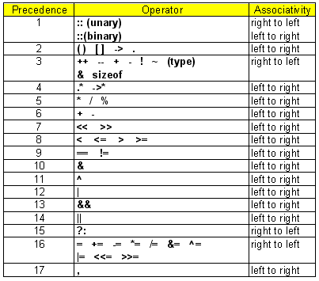
Precedence and Associative

Slide 29
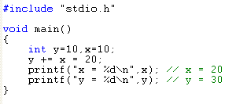
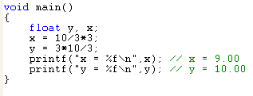
Precedence and Associative: Example

Slide 30
Exercise
If all variables are integer, then state the value of A if:
B=23; C=12; D=32; E=0;
A = B && E;
A = B & C;
A = C || D;
A = B | D;
A = B > 2;
A = B >> 2;
A = C < 3;
A = C << 3;
A = B = C;
A = B == C;

Slide 31
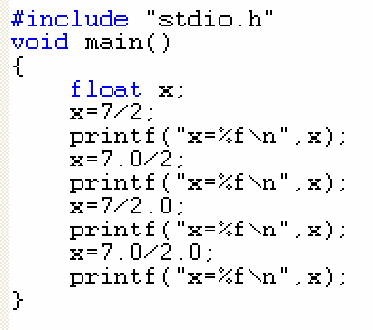
Exercise
What is x value on the screen ?
#include <stdio.h>
int main()
{
int x=10, y=6;
x *= 5 + y;
printf("%d\n",x);
return(0);
}
What is x value on the screen ?

Slide 32
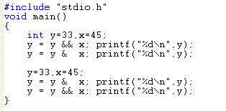
Exercise
What is y value on the screen ?

Slide 33
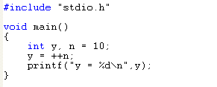
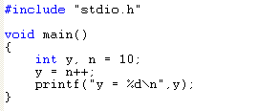
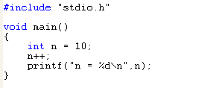

Exercise
What are the output of those programs?

Slide 34
Exercise
z = (n > 0) ? f : b;
From the given conditional expression above, do f and b have a different data type?

Slide 35
Summary
Operator is a symbol to process values in result for a new value
Operand is part which specifies what data is to be manipulated or operated on
Every operator will have precedence and associative

Slide 36
References
Paul J. Dietel,Harvey M. Deitel,. 2010. C : how to program. PEAPH. New Jersey. ISBN:978-0-13-705966-9 Chapter 2, 3 & 4
Manipulating Data with Operators: http://aelinik.free.fr/c/ch06.htm

Slide 37
END

